Slide 1
COM/BLM 376 Computer Architecture Chapter 8 Operating System Support
Asst. Prof. Dr. Gazi Erkan BOSTANCI
ebostanci@ankara.edu.tr
Slides are mainly based on
Computer Organization and Architecture: Designing for Performance by William Stallings, 9th Edition, Prentice Hall

Slide 2
Although the focus of this course is computer hardware, there is one area of software that needs to be addressed: the computer’s OS. The OS is a program that manages the computer’s resources, provides services for programmers, and schedules the execution of other programs.
Some understanding of operating systems is essential to appreciate the mechanisms by which the CPU controls the computer system.
In particular, explanations of the effect of interrupts and of the management of the memory hierarchy are best explained in this context.

Slide 3
Outline
Operating System Overview
Scheduling
Memory Management

Slide 4
OPERATING SYSTEM OVERVIEW
Operating System Objectives and Functions
An OS is a program that controls the execution of application programs and acts as an interface between applications and the computer hardware.
It can be thought of as having two objectives:
Convenience: An OS makes a computer more convenient to use.
Efficiency: An OS allows the computer system resources to be used in an efficient manner.

Slide 5
The Operating System As A User/Computer Interface
The hardware and software used in providing applications to a user can be viewed in a layered or hierarchical fashion, as depicted in Figure below.

Slide 6
The user of those applications, the end user, generally is not concerned with the computer’s architecture. Thus the end user views a computer system in terms of an application.
That application can be expressed in a programming language and is developed by an application programmer. To develop an application program as a set of processor instructions that is completely responsible for controlling the computer hardware would be an overwhelmingly complex task.
To ease this task, a set of systems programs is provided. Some of these programs are referred to as utilities.

Slide 7
These implement frequently used functions that assist in program creation, the management of files, and the control of I/O devices. A programmer makes use of these facilities in developing an application, and the application, while it is running, invokes the utilities to perform certain functions. The most important system program is the OS.
The OS masks the details of the hardware from the programmer and provides the programmer with a convenient interface for using the system. It acts as mediator, making it easier for the programmer and for application programs to access and use those facilities and services.

Slide 8
Briefly, the OS typically provides services in the following areas:
Program creation: The OS provides a variety of facilities and services, such as editors and debuggers, to assist the programmer in creating programs. Typically, these services are in the form of utility programs that are not actually part of the OS but are accessible through the OS.
Program execution: A number of steps need to be performed to execute a program. Instructions and data must be loaded into main memory, I/O devices and files must be initialized, and other resources must be prepared. The OS handles all of this for the user.
Access to I/O devices: Each I/O device requires its own specific set of instructions or control signals for operation. The OS takes care of the details so that the programmer can think in terms of simple reads and writes.
Controlled access to files: In the case of files, control must include an understanding of not only the nature of the I/O device (disk drive, tape drive) but also the file format on the storage medium. Again, the OS worries about the details. Further, in the case of a system with multiple simultaneous users, the OS can provide protection mechanisms to control access to the files.

Slide 9
System access: In the case of a shared or public system, the OS controls access to the system as a whole and to specific system resources. The access function must provide protection of resources and data from unauthorized users and must resolve conflicts for resource contention.
Error detection and response: A variety of errors can occur while a computer system is running. These include internal and external hardware errors, such as a memory error, or a device failure or malfunction; and various software errors, such as arithmetic overflow, attempt to access forbidden memory location, and inability of the OS to grant the request of an application. In each case, the OS must make the response that clears the error condition with the least impact on running applications. The response may range from ending the program that caused the error, to retrying the operation, to simply reporting the error to the application.
Accounting: A good OS collects usage statistics for various resources and monitor performance parameters such as response time. On any system, this information is useful in anticipating the need for future enhancements and in tuning the system to improve performance. On a multiuser system, the information can be used for billing purposes.

Slide 10
Figure above also indicates three key interfaces in a typical computer system:
Instruction set architecture (ISA): The ISA defines the repertoire of machine language instructions that a computer can follow. This interface is the boundary between hardware and software. Note that both application programs and utilities may access the ISA directly. For these programs, a subset of the instruction repertoire is available (user ISA). The OS has access to additional machine language instructions that deal with managing system resources (system ISA).
Application binary interface (ABI): The ABI defines a standard for binary portability across programs. The ABI defines the system call interface to the operating system and the hardware resources and services available in a system through the user ISA.
Application programming interface (API): The API gives a program access to the hardware resources and services available in a system through the user ISA supplemented with high-level language (HLL) library calls. Any system calls are usually performed through libraries. Using an API enables application software to be ported easily, through recompilation, to other systems that support the same API.

Slide 11
The Operating System As Resource Manager
A computer is a set of resources for the movement, storage, and processing of data and for the control of these functions. The OS is responsible for managing these resources.
Can we say that the OS controls the movement, storage, and processing of data?
From one point of view, the answer is yes: By managing the computer’s resources, the OS is in control of the computer’s basic functions. But this control is exercised in a curious way. Normally, we think of a control mechanism as something external to that which is controlled, or at least as something that is a distinct and separate part of that which is controlled.

Slide 12
For example, a residential heating system is controlled by a thermostat, which is completely distinct from the heat-generation and heat-distribution apparatus.
This is not the case with the OS, which as a control mechanism is unusual in two respects:
The OS functions in the same way as ordinary computer software; that is, it is a program executed by the processor.
The OS frequently relinquishes control and must depend on the processor to allow it to regain control.

Slide 13
Like other computer programs, the OS provides instructions for the processor. The key difference is in the intent of the program. The OS directs the processor in the use of the other system resources and in the timing of its execution of other programs.
But in order for the processor to do any of these things, it must cease executing the OS program and execute other programs. Thus, the OS relinquishes control for the processor to do some “useful” work and then resumes control long enough to prepare the processor to do the next piece of work.
The mechanisms involved in all this should become clear as the chapter proceeds.

Slide 14
Figure suggests the main resources that are managed by the OS.
A portion of the OS is in main memory. This includes the kernel, or nucleus, which contains the most frequently used functions in the OS and, at a given time, other portions of the OS currently in use.

Slide 15
The remainder of main memory contains user programs and data. The allocation of this resource (main memory) is controlled jointly by the OS and memory-management hardware in the processor, as we shall see. The OS decides when an I/O device can be used by a program in execution, and controls access to and use of files.
The processor itself is a resource, and the OS must determine how much processor time is to be devoted to the execution of a particular user program. In the case of a multiple-processor system, this decision must span all of the processors.

Slide 16
SCHEDULING
The key to multiprogramming is scheduling. In fact, four types of scheduling are typically involved.

Slide 17
Long-Term Scheduling
The long-term scheduler determines which programs are admitted to the system for processing. Thus, it controls the degree of multiprogramming (number of processes in memory).
Once admitted, a job or user program becomes a process and is added to the queue for the short-term scheduler.
In some systems, a newly created process begins in a swapped-out condition, in which case it is added to a queue for the medium-term scheduler.

Slide 18
In a batch system, or for the batch portion of a general-purpose OS, newly submitted jobs are routed to disk and held in a batch queue. The long-term scheduler creates processes from the queue when it can. There are two decisions involved here.
First, the scheduler must decide that the OS can take on one or more additional processes.
Second, the scheduler must decide which job or jobs to accept and turn into processes. The criteria used may include priority, expected execution time, and I/O requirements.

Slide 19
Medium-Term Scheduling
Medium-term scheduling is part of the swapping function. Typically, the swapping-in decision is based on the need to manage the degree of multiprogramming. On a system that does not use virtual memory, memory management is also an issue. Thus, the swapping-in decision will consider the memory requirements of the swapped-out processes.
Short-Term Scheduling
The long-term scheduler executes relatively infrequently and makes the coarse-grained decision of whether or not to take on a new process, and which one to take. The short-term scheduler, also known as the dispatcher, executes frequently and makes the fine-grained decision of which job to execute next.

Slide 20
PROCESS STATES
To understand the operation of the short-term scheduler, we need to consider the concept of a process state.
During the lifetime of a process, its status will change a number of times. Its status at any point in time is referred to as a state.
The term state is used because it connotes that certain information exists that defines the status at that point. At minimum, there are five defined states for a process.

Slide 22
New: A program is admitted by the high-level scheduler but is not yet ready to execute. The OS will initialize the process, moving it to the ready state.
Ready: The process is ready to execute and is awaiting access to the processor.
Running: The process is being executed by the processor.
Waiting: The process is suspended from execution waiting for some system resource, such as I/O.
Halted: The process has terminated and will be destroyed by the OS.

Slide 23
For each process in the system, the OS must maintain information indicating the state of the process and other information necessary for process execution. For this purpose, each process is represented in the OS by a process control block, which typically contains
Identifier: Each current process has a unique identifier.
State: The current state of the process (new, ready, and so on).
Priority: Relative priority level.
Program counter: The address of the next instruction in the program to be executed.
Memory pointers: The starting and ending locations of the process in memory.
Context data: These are data that are present in registers in the processor while the process is executing.
I/O status information: Includes outstanding I/O requests, I/O devices (e.g., tape drives) assigned to this process, a list of files assigned to the process, and so on.
Accounting information: May include the amount of processor time and clock time used, time limits, account numbers, and so on.

Slide 24
When the scheduler accepts a new job or user request for execution, it creates a blank process control block and places the associated process in the new state.
After the system has properly filled in the process control block, the process is transferred to the ready state.

Slide 25
SCHEDULING TECHNIQUES To understand how the OS manages the scheduling of the various jobs in memory, let us begin by considering the simple example in Figure below.
The figure shows how main memory is partitioned at a given point in time. The kernel of the OS is, of course, always resident. In addition, there are a number of active processes, including A and B, each of which is allocated a portion of memory.

Slide 27
We begin at a point in time when process A is running. The processor is executing instructions from the program contained in A’s memory partition. At some later point in time, the processor ceases to execute instructions in A and begins executing instructions in the OS area. This will happen for one of three reasons:
Process A issues a service call (e.g., an I/O request) to the OS. Execution of A is suspended until this call is satisfied by the OS.
Process A causes an interrupt. An interrupt is a hardware-generated signal to the processor. When this signal is detected, the processor ceases to execute A and transfers to the interrupt handler in the OS. A variety of events related to A will cause an interrupt.
One example is an error, such as attempting to execute a privileged instruction.
Another example is a timeout; to prevent any one process from monopolizing the processor, each process is only granted the processor for a short period at a time.
Some event unrelated to process A that requires attention causes an interrupt. An example is the completion of an I/O operation.

Slide 28
In any case, the result is the following. The processor saves the current context data and the program counter for A in A’s process control block and then begins executing in the OS. The OS may perform some work, such as initiating an I/O operation.
Then the short-term-scheduler portion of the OS decides which process should be executed next. In this example, B is chosen. The OS instructs the processor to restore B’s context data and proceed with the execution of B where it left off.

Slide 29
Figure shows the major elements of the OS involved in the multiprogramming and scheduling of processes.
The OS receives control of the processor at the interrupt handler if an interrupt occurs and at the service-call handler if a service call occurs.
Once the interrupt or service call is handled, the short-term scheduler is invoked to select a process for execution.

Slide 30
To do its job, the OS maintains a number of queues. Each queue is simply a waiting list of processes waiting for some resource.
The long-term queue is a list of jobs waiting to use the system. As conditions permit, the high-level scheduler will allocate memory and create a process for one of the waiting items.
The short-term queue consists of all processes in the ready state. Any one of these processes could use the processor next. It is up to the short-term scheduler to pick one. Generally, this is done with a round-robin algorithm, giving each process some time in turn. Priority levels may also be used.
Finally, there is an I/O queue for each I/O device. More than one process may request the use of the same I/O device. All processes waiting to use each device are lined up in that device’s queue.

Slide 31
Figure suggests how processes progress through the computer under the control of the OS. Each process request (batch job, user-defined interactive job) is placed in the long-term queue.
As resources become available, a process request becomes a process and is then placed in the ready state and put in the short-term queue. The processor alternates between executing OS instructions and executing user processes.
While the OS is in control, it decides which process in the short-term queue should be executed next. When the OS has finished its immediate tasks, it turns the processor over to the chosen process.

Slide 32
As was mentioned earlier, a process being executed may be suspended for a variety of reasons.
If it is suspended because the process requests I/O, then it is placed in the appropriate I/O queue.
If it is suspended because of a timeout or because the OS must attend to pressing business, then it is placed in the ready state and put into the short-term queue.
Finally, we mention that the OS also manages the I/O queues. When an I/O operation is completed, the OS removes the satisfied process from that I/O queue and places it in the short-term queue. It then selects another waiting process (if any) and signals for the I/O device to satisfy that process’ request.

Slide 33
MEMORY MANAGEMENT
In a uni-programming system, main memory is divided into two parts: one part for the OS (resident monitor) and one part for the program currently being executed. In a multi-programming system, the “user” part of memory is subdivided to accommodate multiple processes. The task of subdivision is carried out dynamically by the OS and is known as memory management.
Effective memory management is vital in a multiprogramming system. If only a few processes are in memory, then for much of the time all of the processes will be waiting for I/O and the processor will be idle. Thus, memory needs to be allocated efficiently to pack as many processes into memory as possible.

Slide 34
Swapping
We have discussed three types of queues:
the long-term queue of requests for new processes,
the short-term queue of processes ready to use the processor,
and the various I/O queues of processes that are not ready to use the processor.
Recall that the reason for this elaborate machinery is that I/O activities are much slower than computation and therefore the processor in a uni-programming system is idle most of the time.

Slide 35
But the arrangement in figure above does not entirely solve the problem.
It is true that, in this case, memory holds multiple processes and that the processor can move to another process when one process is waiting. But the processor is so much faster than I/O that it will be common for all the processes in memory to be waiting on I/O. Thus, even with multi-programming, a processor could be idle most of the time.
What to do? Main memory could be expanded, and so be able to accommodate more processes. But there are two flaws in this approach.
First, main memory is expensive, even today.
Second, the appetite of programs for memory has grown as fast as the cost of memory has dropped. So larger memory results in larger processes, not more processes.

Slide 36
Another solution is swapping, depicted in the figure . We have a long-term queue of process requests, typically stored on disk. These are brought in, one at a time, as space becomes available.
As processes are completed, they are moved out of main memory. Now the situation will arise that none of the processes in memory are in the ready state (e.g., all are waiting on an I/O operation).
Rather than remain idle, the processor swaps one of these processes back out to disk into an intermediate queue. This is a queue of existing processes that have been temporarily kicked out of memory. The OS then brings in another process from the intermediate queue, or it honors a new process request from the long-term queue. Execution then continues with the newly arrived process.

Slide 37
Swapping, however, is an I/O operation, and therefore there is the potential for making the problem worse, not better. But because disk I/O is generally the fastest I/O on a system (e.g., compared with tape or printer I/O), swapping will usually enhance performance.
A more sophisticated scheme, involving virtual memory, improves performance over simple swapping.
This will be discussed shortly. But first, we must prepare the ground by explaining partitioning and paging.

Slide 38
Partitioning
The simplest scheme for partitioning available memory is to use fixed-size partitions, as shown in the figure. Note that, although the partitions are of fixed size, they need not be of equal size. When a process is brought into memory, it is placed in the smallest available partition that will hold it.
Even with the use of unequal fixed-size partitions, there will be wasted memory. In most cases, a process will not require exactly as much memory as provided by the partition. For example, a process that requires 3M bytes of memory would be placed in the 4M partition of Figure (b), wasting 1M that could be used by another process.
A more efficient approach is to use variable-size partitions. When a process is brought into memory, it is allocated exactly as much memory as it requires and no more.

Slide 39
Example
Initially, main memory is empty, except for the OS (a). The first three processes are loaded in, starting where the OS ends and occupying just enough space for each process (b, c, d). This leaves a “hole” at the end of memory that is too small for a fourth process.
At some point, none of the processes in memory is ready. The OS swaps out process 2 (e), which leaves sufficient room to load a new process, process 4 (f). Because process 4 is smaller than process 2, another small hole is created.
Later, a point is reached at which none of the processes in main memory is ready, but process 2, in the Ready-Suspend state, is available. Because there is insufficient room in memory for process 2, the OS swaps process 1 out (g) and swaps process 2 back in (h).

Slide 40
As this example shows, this method starts out well, but eventually it leads to a situation in which there are a lot of small holes in memory. As time goes on, memory becomes more and more fragmented, and memory utilization declines.
One technique for overcoming this problem is compaction: From time to time, the OS shifts the processes in memory to place all the free memory together in one block.
This is a time-consuming procedure, wasteful of processor time.

Slide 41
Considering the figure above; it should be obvious that a process is not likely to be loaded into the same place in main memory each time it is swapped in.
Furthermore, if compaction is used, a process may be shifted while in main memory. A process in memory consists of instructions plus data. The instructions will contain addresses for memory locations of two types:
Addresses of data items
Addresses of instructions, used for branching instructions
But these addresses are not fixed. They will change each time a process is swapped in. To solve this problem, a distinction is made between logical addresses and physical addresses.

Slide 42
A logical address is expressed as a location relative to the beginning of the program. Instructions in the program contain only logical addresses. A physical address is an actual location in main memory.
When the processor executes a process, it automatically converts from logical to physical address by adding the current starting location of the process, called its base address, to each logical address. This is another example of a processor hardware feature designed to meet an OS requirement. The exact nature of this hardware feature depends on the memory management strategy in use.

Slide 43
Paging
Both unequal fixed-size and variable-size partitions are inefficient in the use of memory. Suppose, however, that memory is partitioned into equal fixed-size chunks that are relatively small, and that each process is also divided into small fixed-size chunks of some size.
Then the chunks of a program, known as pages, could be assigned to available chunks of memory, known as frames, or page frames. At most, then, the wasted space in memory for that process is a fraction of the last page.

Slide 44
Figure shows an example of the use of pages and frames. At a given point in time, some of the frames in memory are in use and some are free. The list of free frames is maintained by the OS. Process A, stored on disk, consists of four pages.
When it comes time to load this process, the OS finds four free frames and loads the four pages of the process A into the four frames.

Slide 45
Now suppose, as in this example, that there are not sufficient unused contiguous frames to hold the process. Does this prevent the OS from loading A?
The answer is no, because we can once again use the concept of logical address. A simple base address will no longer suffice. Rather, the OS maintains a page table for each process. The page table shows the frame location for each page of the process.
Within the program, each logical address consists of a page number and a relative address within the page.

Slide 46
Recall that in the case of simple partitioning, a logical address is the location of a word relative to the beginning of the program; the processor translates that into a physical address.
With paging, the logical-to-physical address translation is still done by processor hardware. The processor must know how to access the page table of the current process.
Presented with a logical address (page number, relative address), the processor uses the page table to produce a physical address (frame number, relative address).

Slide 47
An example is shown in the figure.
This approach solves the problems raised earlier. Main memory is divided into many small equal-size frames.
Each process is divided into frame-size pages: smaller processes require fewer pages, larger processes require more. When a process is brought in, its pages are loaded into available frames, and a page table is set up.

Slide 48
Virtual Memory
DEMAND PAGING With the use of paging, truly effective multiprogramming systems came into being. Furthermore, the simple tactic of breaking a process up into pages led to the development of another important concept: virtual memory.
To understand virtual memory, we must add a refinement to the paging scheme just discussed. That refinement is demand paging, which simply means that each page of a process is brought in only when it is needed, that is, on demand.

Slide 49
Consider a large process, consisting of a long program plus a number of arrays of data. Over any short period of time, execution may be confined to a small section of the program (e.g., a subroutine), and perhaps only one or two arrays of data are being used. This is the principle of locality.
It would clearly be wasteful to load in dozens of pages for that process when only a few pages will be used before the program is suspended. We can make better use of memory by loading in just a few pages.
Then, if the program branches to an instruction on a page not in main memory, or if the program references data on a page not in memory, a page fault is triggered. This tells the OS to bring in the desired page.

Slide 50
Thus, at any one time, only a few pages of any given process are in memory, and therefore more processes can be maintained in memory. Furthermore, time is saved because unused pages are not swapped in and out of memory. However, the OS must be clever about how it manages this scheme.
When it brings one page in, it must throw another page out; this is known as page replacement. If it throws out a page just before it is about to be used, then it will just have to go get that page again almost immediately.
Too much of this leads to a condition known as thrashing: the processor spends most of its time swapping pages rather than executing instructions.

Slide 51
With demand paging, it is not necessary to load an entire process into main memory. This fact has a remarkable consequence: It is possible for a process to be larger than all of main memory.
One of the most fundamental restrictions in programming has been lifted. Without demand paging, a programmer must be acutely aware of how much memory is available. If the program being written is too large, the programmer must devise ways to structure the program into pieces that can be loaded one at a time.
With demand paging, that job is left to the OS and the hardware. As far as the programmer is concerned, he or she is dealing with a huge memory, the size associated with disk storage.

Slide 52
Because a process executes only in main memory, that memory is referred to as real memory. But a programmer or user perceives a much larger memory—that which is allocated on the disk. This latter is therefore referred to as virtual memory.
Virtual memory allows for very effective multiprogramming and relieves the user of the unnecessarily tight constraints of main memory.

Slide 53
PAGE TABLE STRUCTURE The basic mechanism for reading a word from memory involves the translation of a virtual, or logical, address, consisting of page number and offset, into a physical address, consisting of frame number and offset, using a page table.
Because the page table is of variable length, depending on the size of the process, we cannot expect to hold it in registers. Instead, it must be in main memory to be accessed.

Slide 54
Figure above suggests a hardware implementation of this scheme.
When a particular process is running, a register holds the starting address of the page table for that process. The page number of a virtual address is used to index that table and look up the corresponding frame number.
This is combined with the offset portion of the virtual address to produce the desired real address.

Slide 55
In most systems, there is one page table per process. But each process can occupy huge amounts of virtual memory. For example, in the VAX architecture, each process can have up to 2³¹ = 2 Gbytes of virtual memory. Using 2⁹ = 512-byte pages, that means that as many as 2²² page table entries are required per process.
Clearly, the amount of memory devoted to page tables alone could be unacceptably high.
To overcome this problem, most virtual memory schemes store page tables in virtual memory rather than real memory. This means that page tables are subject to paging just as other pages are. When a process is running, at least a part of its page table must be in main memory, including the page table entry of the currently executing page.

Slide 56
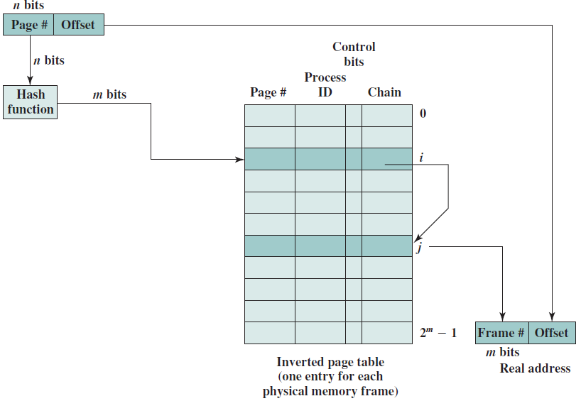
An alternative approach to the use of one- or two-level page tables is the use of an inverted page table structure (Figure ).

Slide 57
In this approach, the page number portion of a virtual address is mapped into a hash value using a simple hashing function. The hash value is a pointer to the inverted page table, which contains the page table entries. There is one entry in the inverted page table for each real memory page frame rather than one per virtual page.
A hash function maps numbers in the range 0 through M into numbers in the range 0 through N, where M ≪ N. The output of the hash function is used as an index into the hash table.
Since more than one input maps into the same output, it is possible for an input item to map to a hash table entry that is already occupied. In that case, the new item must overflow into another hash table location. Typically, the new item is placed in the first succeeding empty space, and a pointer from the original location is provided to chain the entries together.

Slide 58
Thus a fixed proportion of real memory is required for the tables regardless of the number of processes or virtual pages supported.
Because more than one virtual address may map into the same hash table entry, a chaining technique is used for managing the overflow. The hashing technique results in chains that are typically short—between one and two entries.
The page table’s structure is called inverted because it indexes page table entries by frame number rather than by virtual page number.

Slide 59
Translation Lookaside Buffer
In principle, then, every virtual memory reference can cause two physical memory accesses: one to fetch the appropriate page table entry, and one to fetch the desired data.
Thus, a straightforward virtual memory scheme would have the effect of doubling the memory access time. To overcome this problem, most virtual memory schemes make use of a special cache for page table entries, usually called a translation lookaside buffer (TLB).
This cache functions in the same way as a memory cache and contains those page table entries that have been most recently used.

Slide 60
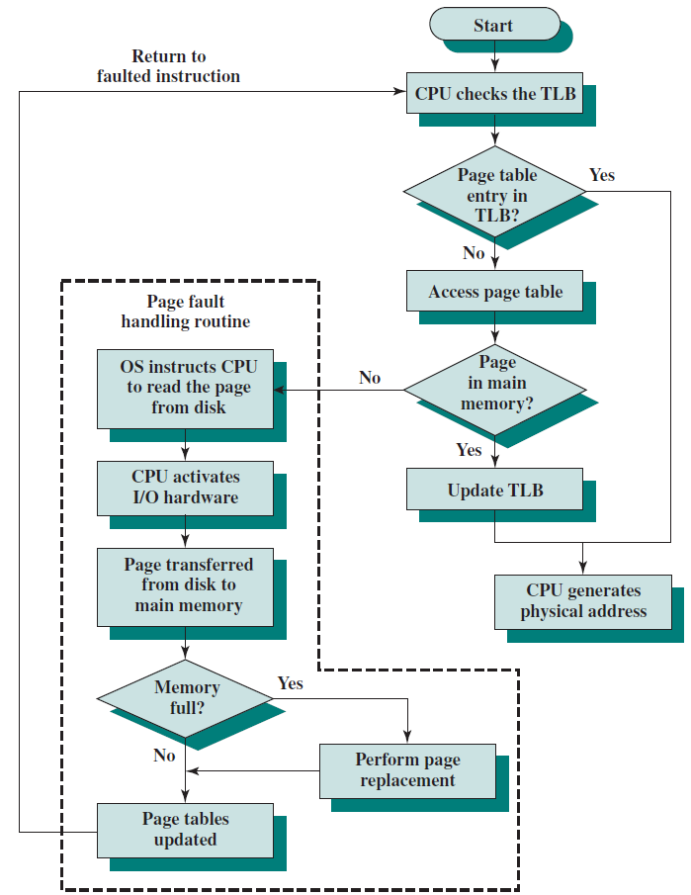
Figure is a flowchart that shows the use of the TLB. By the principle of locality, most virtual memory references will be to locations in recently used pages.
Therefore, most references will involve page table entries in the cache.

Slide 61
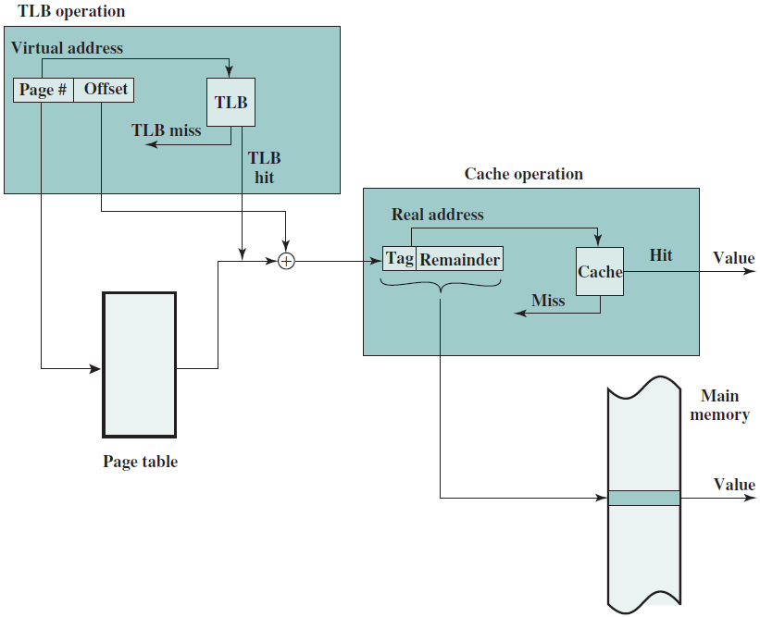
Note that the virtual memory mechanism must interact with the cache system (not the TLB cache, but the main memory cache). This is illustrated in the figure.
A virtual address will generally be in the form of a page number, offset.

Slide 62
First, the memory system consults the TLB to see if the matching page table entry is present.
If it is, the real (physical) address is generated by combining the frame number with the offset. If not, the entry is accessed from a page table.
Once the real address is generated, which is in the form of a tag and a remainder, the cache is consulted to see if the block containing that word is present. If so, it is returned to the processor. If not, the word is retrieved from main memory.

Slide 63
You should be able to appreciate the complexity of the processor hardware involved in a single memory reference.
The virtual address is translated into a real address. This involves reference to a page table, which may be in the TLB, in main memory, or on disk.
The referenced word may be in cache, in main memory, or on disk. In the latter case, the page containing the word must be loaded into main memory and its block loaded into the cache. In addition, the page table entry for that page must be updated.

Slide 64
Segmentation
There is another way in which addressable memory can be subdivided, known as segmentation.
Whereas paging is invisible to the programmer and serves the purpose of providing the programmer with a larger address space, segmentation is usually visible to the programmer and is provided as a convenience for organizing programs and data and as a means for associating privilege and protection attributes with instructions and data.

Slide 65
Segmentation allows the programmer to view memory as consisting of multiple address spaces or segments. Segments are of variable, indeed dynamic, size.
Typically, the programmer or the OS will assign programs and data to different segments.
There may be a number of program segments for various types of programs as well as a number of data segments. Each segment may be assigned access and usage rights. Memory references consist of a (segment number, offset) form of address.

Slide 66
This organization has a number of advantages to the programmer over a non-segmented address space:
It simplifies the handling of growing data structures. If the programmer does not know ahead of time how large a particular data structure will become, it is not necessary to guess. The data structure can be assigned its own segment, and the OS will expand or shrink the segment as needed.
It allows programs to be altered and recompiled independently without requiring that an entire set of programs be relinked and reloaded. Again, this is accomplished using multiple segments.
It lends itself to sharing among processes. A programmer can place a utility program or a useful table of data in a segment that can be addressed by other processes.
It lends itself to protection. Because a segment can be constructed to contain a well-defined set of programs or data, the programmer or a system administrator can assign access privileges in a convenient fashion.

Slide 67
These advantages are not available with paging, which is invisible to the programmer.
On the other hand, we have seen that paging provides for an efficient form of memory management. To combine the advantages of both, some systems are equipped with the hardware and OS software to provide both.

